Slide 1
Fault Tolerance

Slide 2
Fault Tolerance
A characteristic of Distributed Systems is that they are tolerant of partial failures within the distributed system. This is one feature that distinguishes them from non-distributed systems.
A distributed system must be able to recover from partial failures and continue to run in an acceptable way.

Slide 3
Basic Concepts
Availability – probability that the system is operating correctly at any given time.
Reliability – the length of time that a system can run without failure
Safety – if part of (or the whole of) a system fails nothing catastrophic should happen
Maintainability – how easy it is to repair a system

Slide 4
Failure Models
Type of failure | Description
Crash failure | A server halts, but is working correctly until it halts
Omission failure Receive omission Send omission | A server fails to respond to incoming requests A server fails to receive incoming messages A server fails to send messages
Timing failure | A server's response lies outside the specified time interval
Response failure Value failure State transition failure | The server's response is incorrect The value of the response is wrong The server deviates from the correct flow of control
Arbitrary failure | A server may produce arbitrary responses at arbitrary times

Slide 5
Failure Masking by Redundancy
If three replicated servers have a mean time between failure of ten days and on average are down for 12 hours when they fail what is the availability of the service?

Slide 6
Failure Masking by Redundancy
If three replicated servers have a mean time between failure of 10 days and on average are down for 12 hours when they fail what is the availability of the service?
Probability that any one server is unavailable:
12/(10*24) or 0.05
Prob. that three servers are unavailable:
0.05³ or 0.000125
Prob. that at least one server is available is:
1-0.000125 or 99.9875

Slide 7
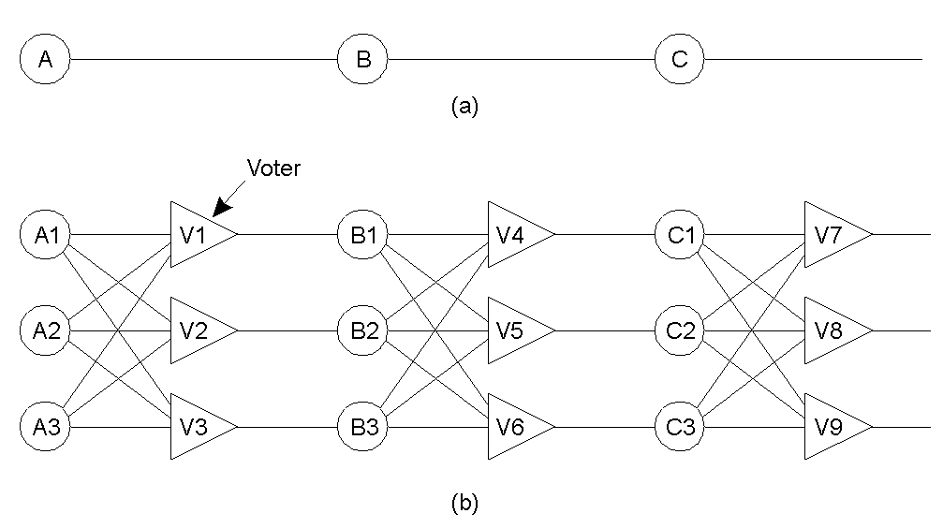
Triple Modular Redundancy

Slide 8
Process Resilience
Design Issues
  Organise identical processes into a group
  Group membership may be dynamic
  Group membership should be hidden from clients
  How requests get to group members must be decided

Slide 9
Agreement in Faulty Systems
Two Army Problem
  Perfect Processes, Faulty Comms (Lost messages)
  Red army (1 x 5000) vs Blue army 2 x 3000)
  Blue 1 to Blue 2 “Attack at dawn?”
  Blue 2 to Blue 1 “OK”
  Blue 1 to Blue 2 “OK message received
  etc. ad infinitem
Agreement between two processes in the face of faulty communication is not possible

Slide 10
Byzantine Generals Problem (1)
Perfect Comms, Imperfect Processes
One red army, n blue armies ( m traitorous generals)
Communication by telephone (fully connected, point to point)
Blue generals want to exchange group strength
Traitorous generals are pathological liars

Slide 11

Byzantine Generals Problem (2)
The Byzantine generals problem for 3 loyal generals and 1 traitor.
The generals announce their troop strengths (in units of 1 kilosoldiers).
The vectors that each general assembles based on (a)
The vectors that each general receives in step 3.

Slide 12
Byzantine Generals Problem (3)
In the final step each general looks for a majority from the vectors received, otherwise marks the troop strength unknown.
Lamport proved that in a system with m faulty processes agreement can only be obtained if there are 2m+1 correctly functioning processes (more than 2/3).

Slide 13
Reliable Group Communication
Often need to send update messages reliable to a group of servers e.g. replicated databases.
Need to know who is in the group
Need to ensure that every message sent gets to every member of the group

Slide 14
Basic Reliable Multicast System (1)
A weak multicast system may only require that all messages get delivered.
This can be simply implemented by sending a monotonically increasing message identifier.
Each receiver acknowledges each message with and acknowledgment.

Slide 15
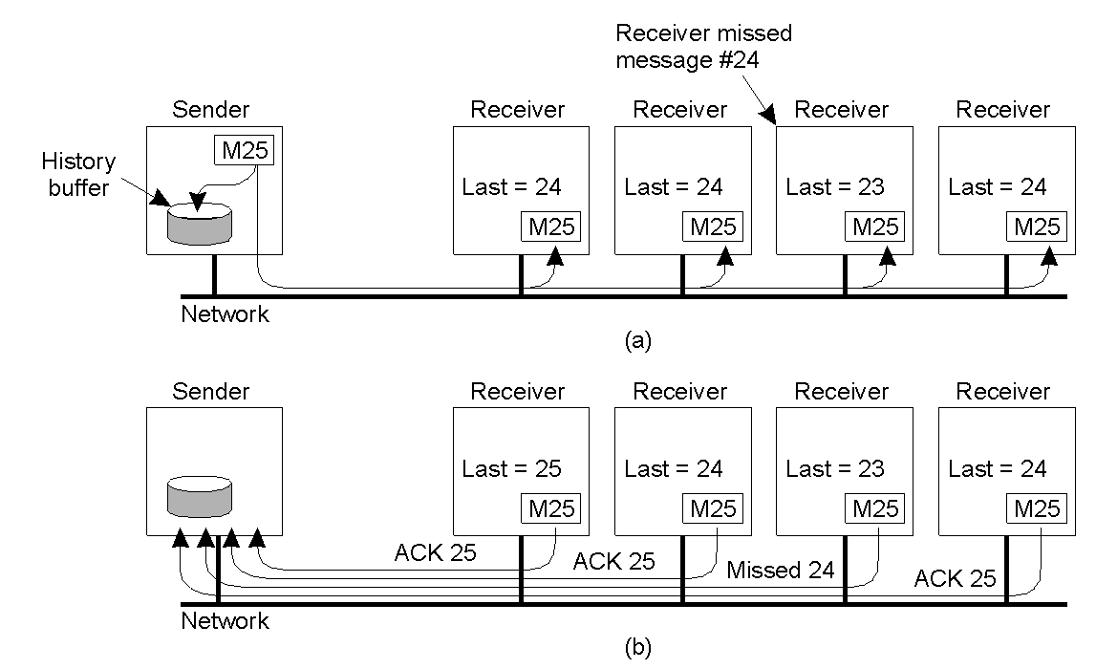
Basic Reliable Multicast System (2)
A simple solution to reliable multicasting when all receivers are known and are assumed not to fail
Message transmission
Reporting feedback

Slide 16
Basic Reliable Multicast System (3)
Not very scaleable if N processes then N-1 acknowledgement messages (Feedback Implosion)
Could return only negative acknowledgements but sender is forced to keep messages sent for an un-bounded time.
Negative acks may be broadcast to further reduce the risk of feedback implosion.
Hierarchical approaches may also be used

Slide 17
Atomic Multicast
Attempts to ensure:
  Messages delivered to all on none of the processes in the group
  Messages are delivered in the same order to every process
Several replicas of a data base may exist
If one crashes a mechanism to deliver the missed messages in the right order must exist

Slide 18
Message Ordering
Reliable Unordered
Reliable FIFO ordered – messages sent from the same process get delivered in the same order
Causally Ordered – if message m1 could have caused message m2 to be sent, m1 must be delivered before m2
Totally Ordered – delivered in same order to all group members

